Slide 1
JNCIS-ENT
Protocol Independent Routing

Slide 2
Protocol Independent Routing Lab
6
Configuring Static Routes, RIB Groups and Routing-Instances

Slide 3
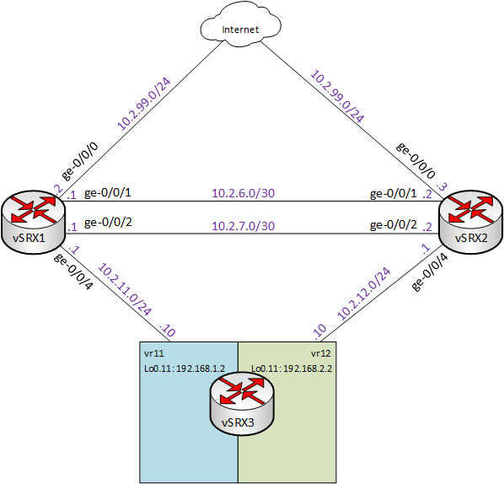
Diagram

Slide 4
Configuring Layer 3 Interfaces
Review starting configuration on vSRX1 and vSRX2
On vSRX1
Configure ge-0/0/1.0 , ge-0/0/2.0 and ge-0/0/4.0 with the following IPv4 addresses
ge-0/0/1.0 – 10.2.7.1/30
ge-0/0/2.0 – 10.2.6.1/30
ge-0/0/4.0 – 10.2.11.1/24
Review the effect on the route table

Slide 5
Configure Static and Aggregate Routes
On vSRX1
Ping 8.8.8.8 and review the messages received
Configure a static default route with a next-hop of 10.2.99.1 and commit
Review the route table for the destination 8.8.8.8
Ping 8.8.8.8 again and review the results
Set the default preference value for all static routes to 20
Configure a static route to the loopback address of vSRX3 and commit
Review the static routing table and validate connectivity to the loopback of vSRX3
Configure an aggregate route to 172.16.0.0/16 and commit
Review the aggregate routing table
Reconfigure the aggregate route to 10.2.0.0/16 and commit
Review the newly configured aggregate route details

Slide 6
Working with Routing Instances
On vSRX1
Configure a virtual-router instance with the following details
instance_1
ge-0/0/1.0 and ge-0/0/2.0
Static routes towards vSRX2 loopback over both ge-0/0/1.0 and ge-0/0/2.0
Static routes towards 10.2.12.0/24 over both ge-0/0/1.0 and ge-0/0/2.0
Commit the configuration and validate connectivity
On vSRX2
Check connectivity to vSRX1 loopback

Slide 7
Working with Routing Instances (cont.)
On vSRX1
Configure a rib-group to copy routes from the default instance to instance_1
Apply to interface routes and static routes
Review the effect on instance_1 route table
Configure a rib-group to copy routes from instance_1 to the default instance
Apply to interface and static routes in the instance_1 routing instance
Review the effect on the default instance route table
Validate connectivity to vSRX2 loopback over instance_1
On vSRX2
1. Validate connectivity to vSRX1 loopback

